Slide 1
WELCOME
A project presentation by…
MUHIBBUR RAHMAN
ID: 0417311001
SUPERVISOR
DR S. M. LUTFUL KABIR
Professor,
IICT, BUET.

Slide 2

Project Title
An Autonomous Alarm System for Preventing Accidents due to Overloading and instability of a Marine Vessel

Slide 3


Problem Statement
Overloading
Instability

Slide 4
OBJECTIVE
To measure the weight at the different portion of the passenger vessels using load cells and Bluetooth.
To calculate total load after receiving data from all the load cells, and determine if the vessel is overloaded.
To calculate the shift in CG of the whole vessel after and to set off the alarm if the CG moves upward beyond the metacenter .

Slide 5
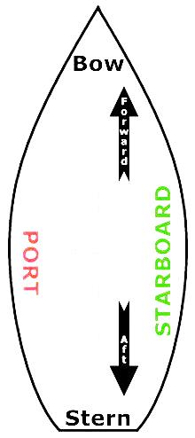
Nautical Orientation
Centerline
Midship

Slide 6
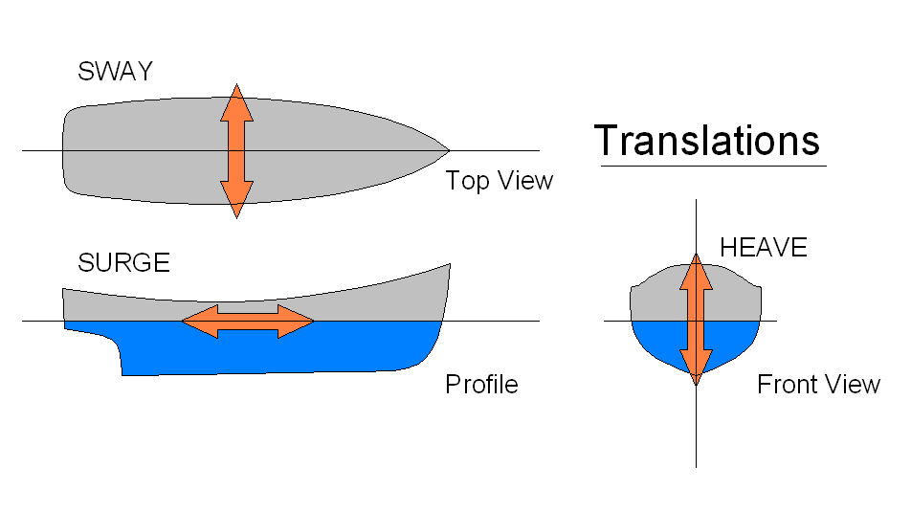
Ship Motion

Slide 7
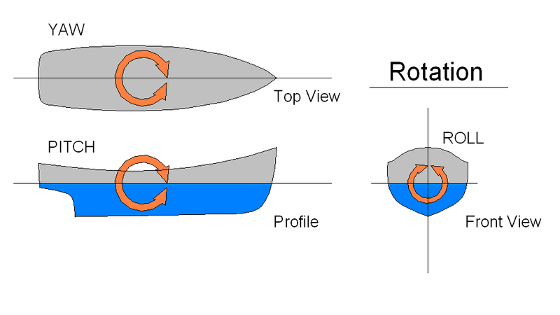
Ship Motion (cont.)

Slide 8
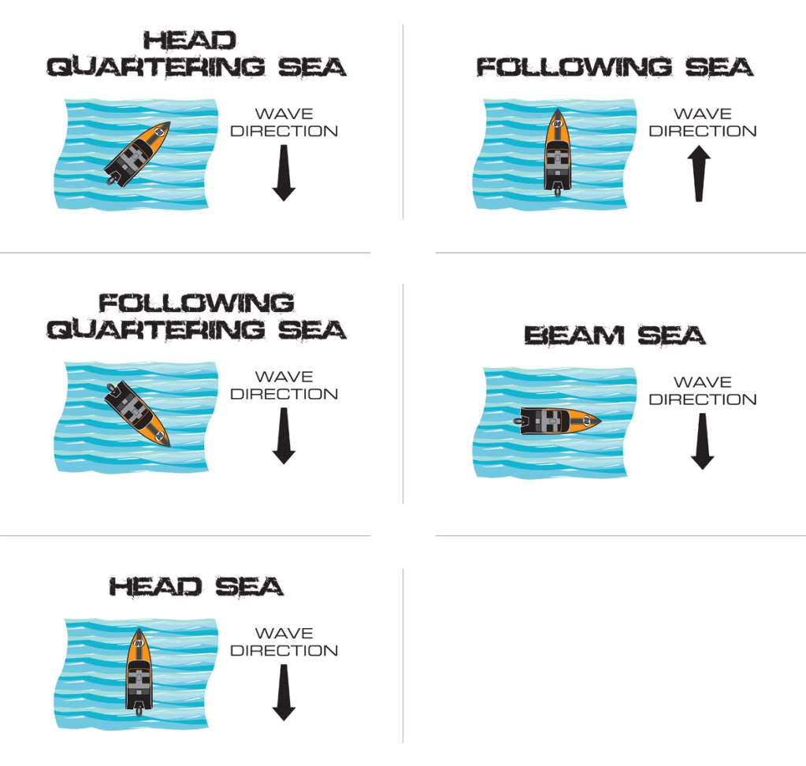
Vessels Interacting with Sea Waves

Slide 9
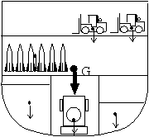
Center of Gravity (CG)
Coordinate of CG

Slide 10
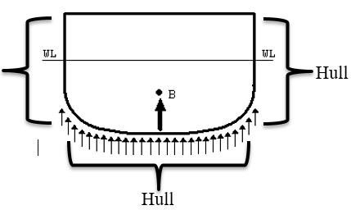
Center of Buoyancy
Hull

Slide 11
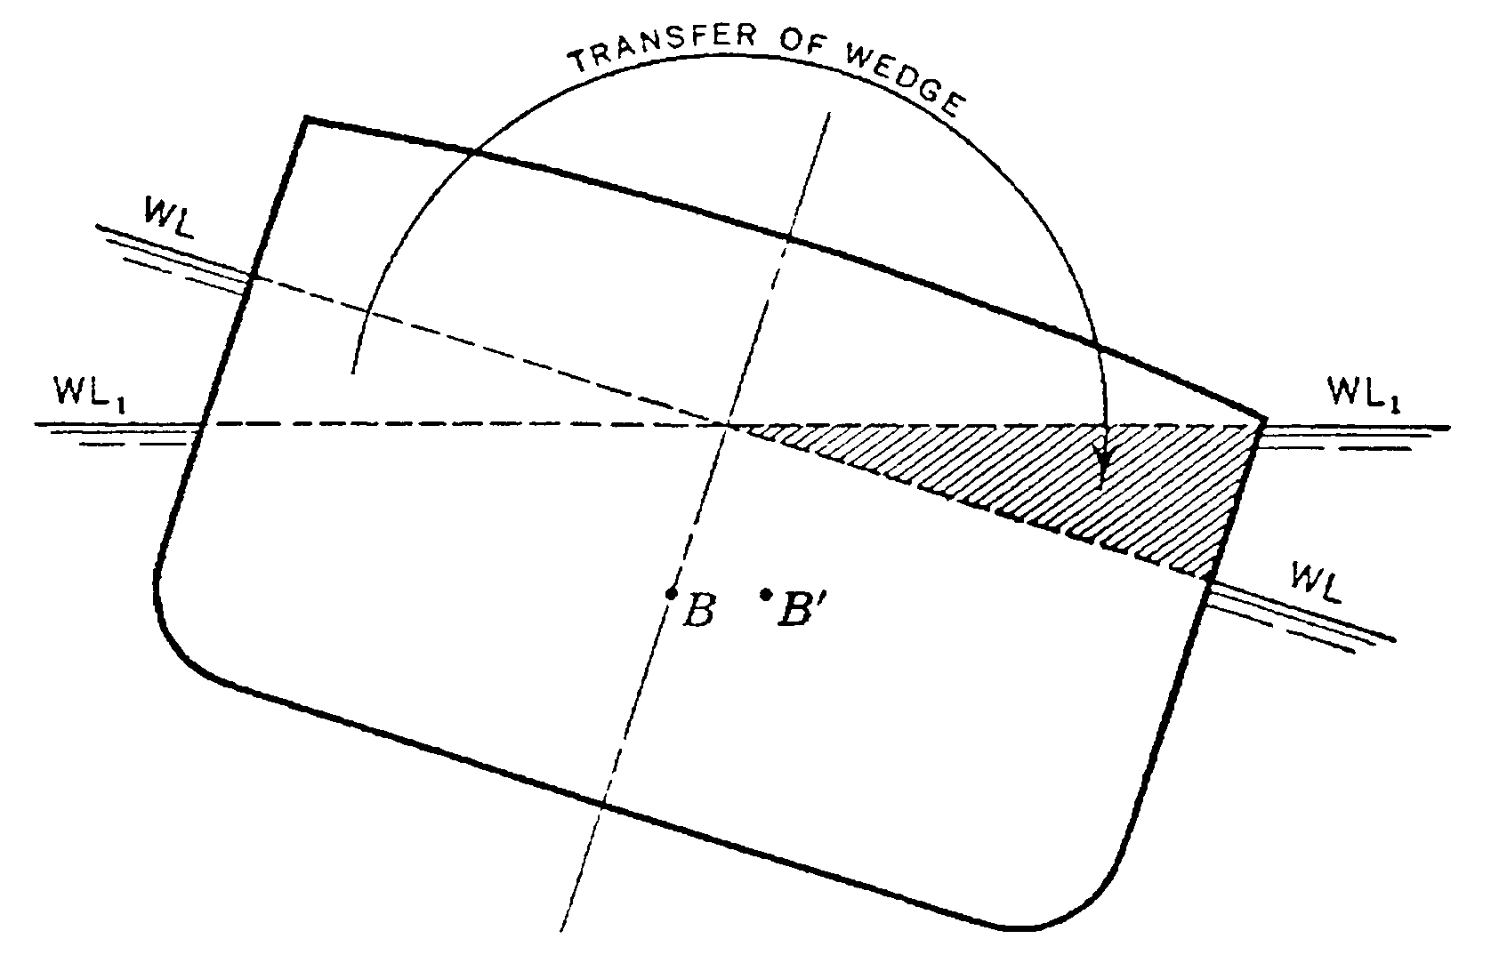
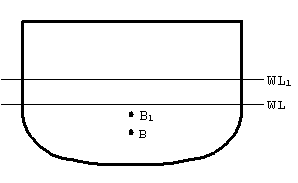
Shift in Center of Buoyancy
Lateral Shift
Vertical Shift

Slide 12
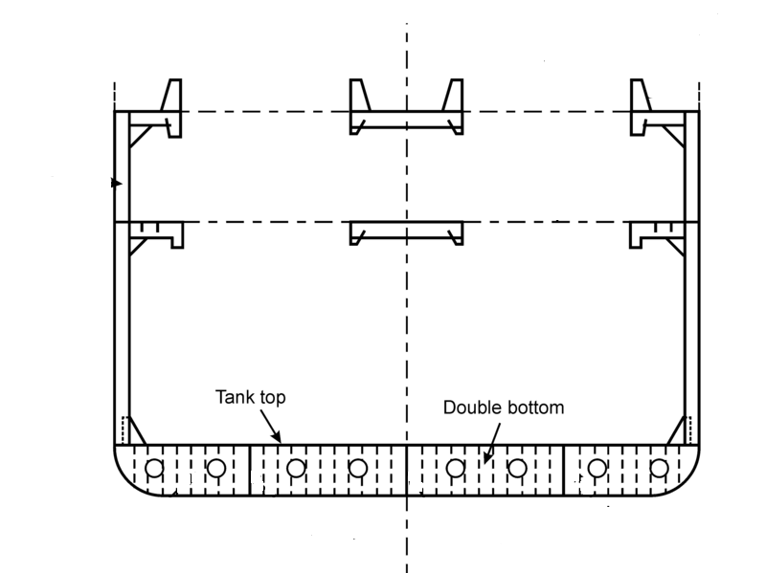
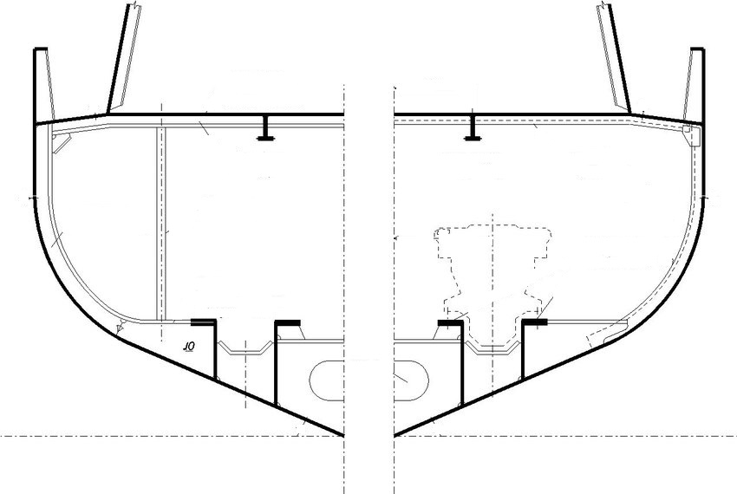
Underwater Contour
Yacht
Cargo Carrier

Slide 13
Vessels Rolling Motion
Heel- Inclined by external forces like waves, wind.
List-Inclined by the forces within. By shifting a weight transversely within the ship.

Slide 14
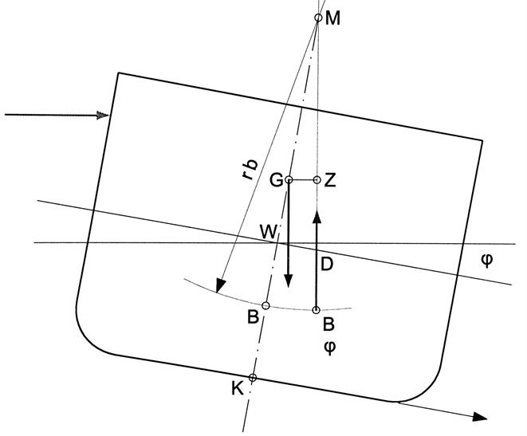
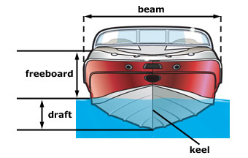
Metacenter and Keel
φ degree Heel

Slide 15
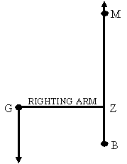
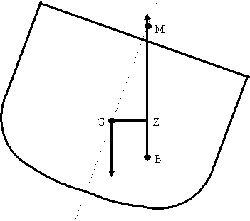
Righting Arm
Righting Couple
Righting Arm

Slide 16
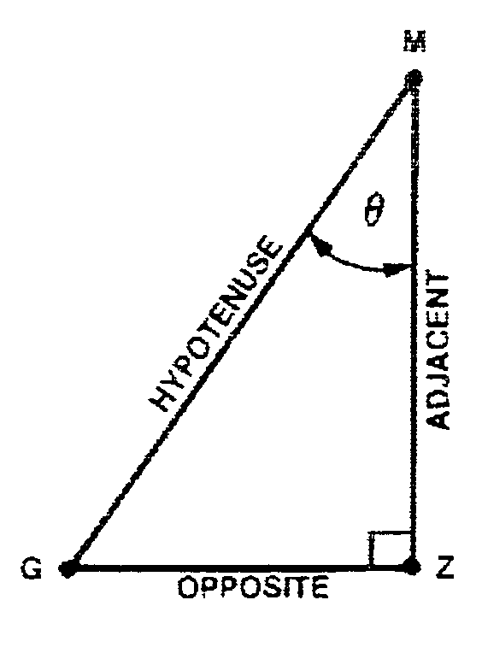
Righting Moment
Where, W_{F} is the total weight of the vessel.

Slide 17
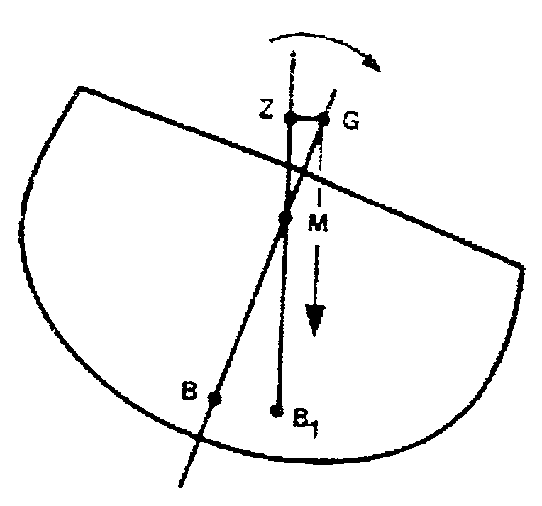
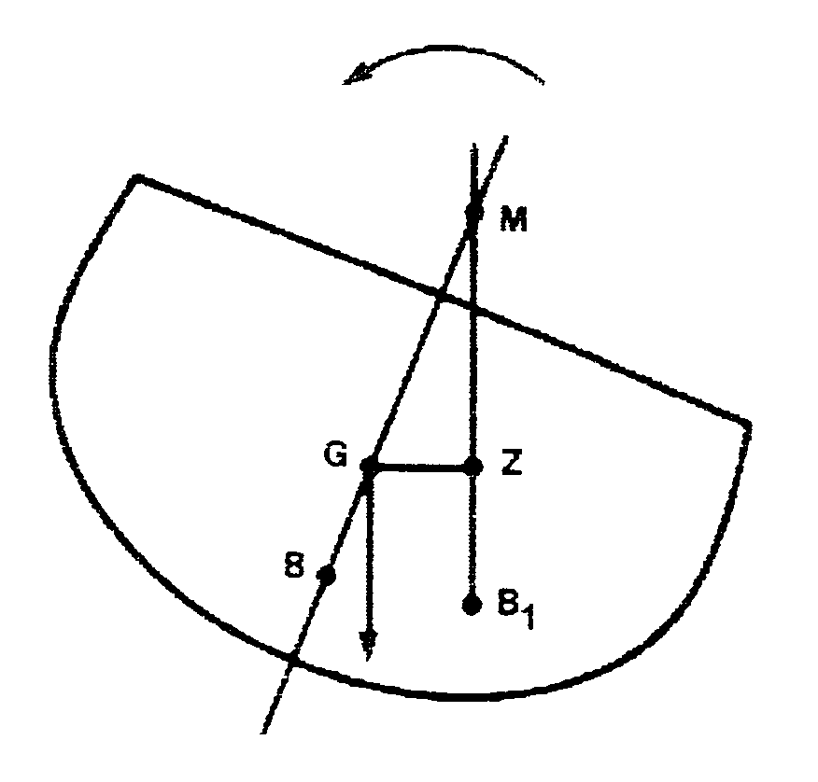
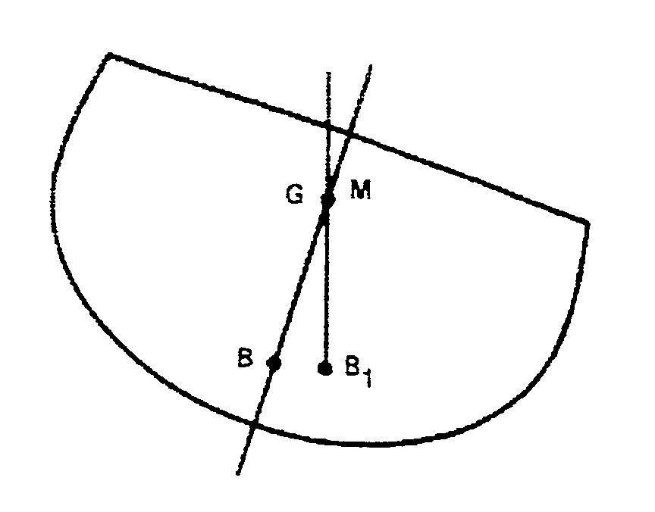
Stability Condition
Positive Stability
Neutral Stability
Negative Stability

Slide 18
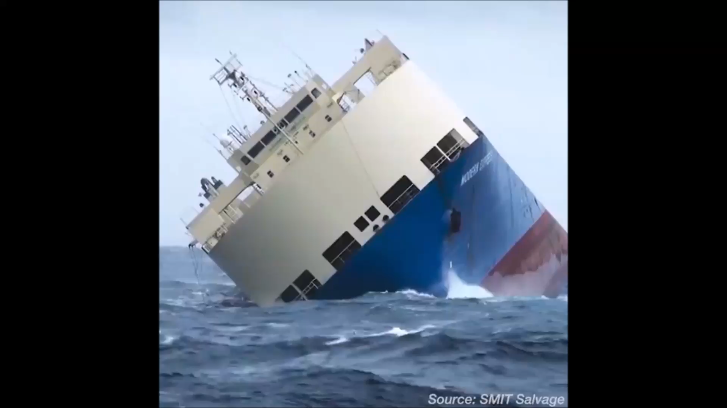

Slide 19
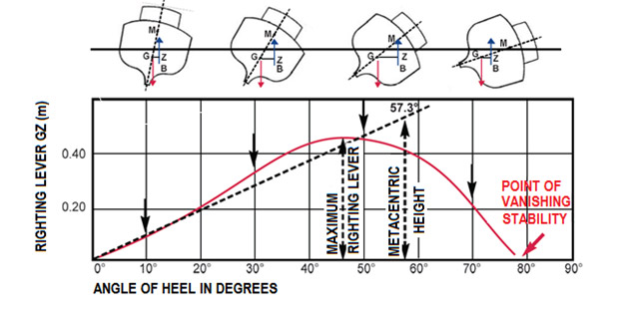
Statical Stability Curve

Slide 20
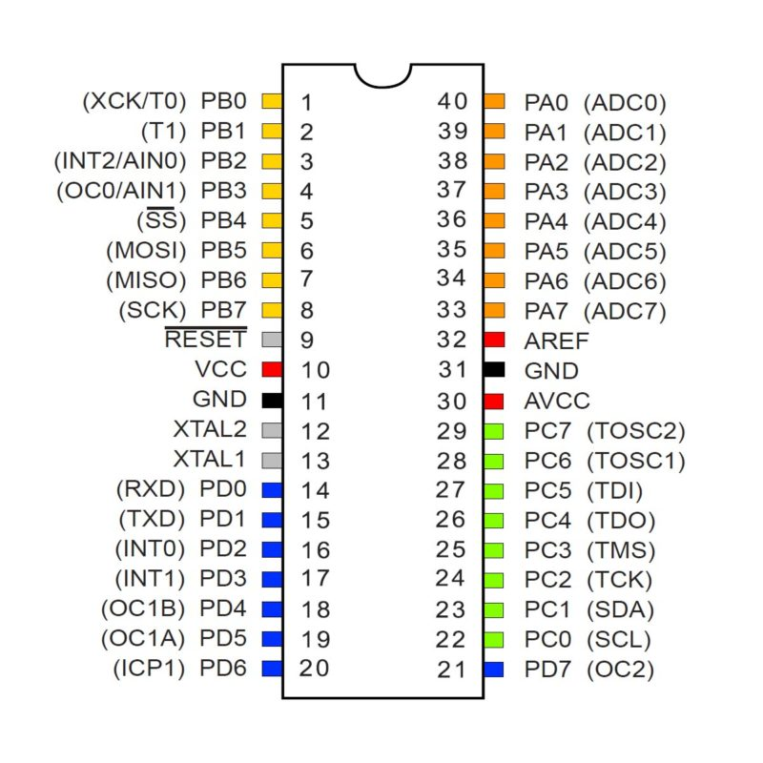
Microcontroller

Slide 21
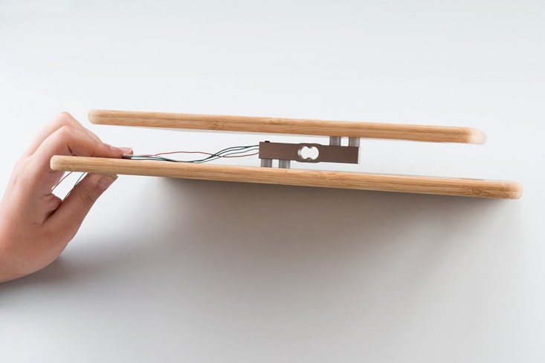
Load Cell Setup in a “Z” Formation

Slide 22
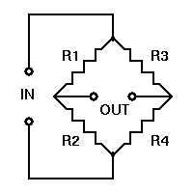
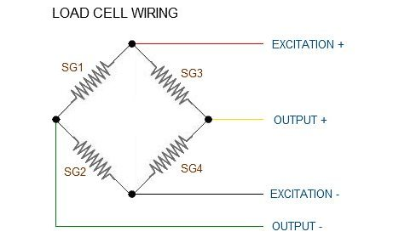
Measurement on the basis of Wheatstone Bridge

Slide 23
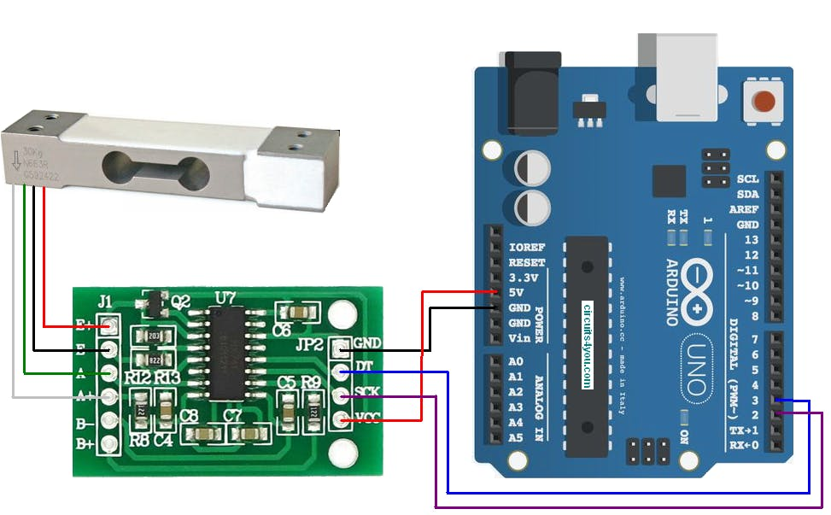
Load Cell Amplifier

Slide 24
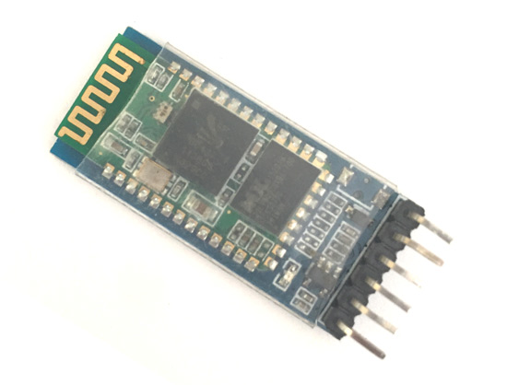
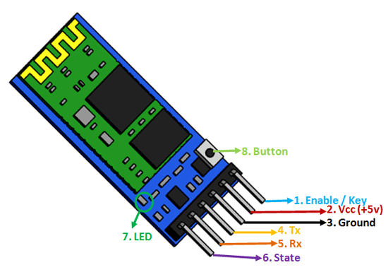
Bluetooth Module HC-05

Slide 25
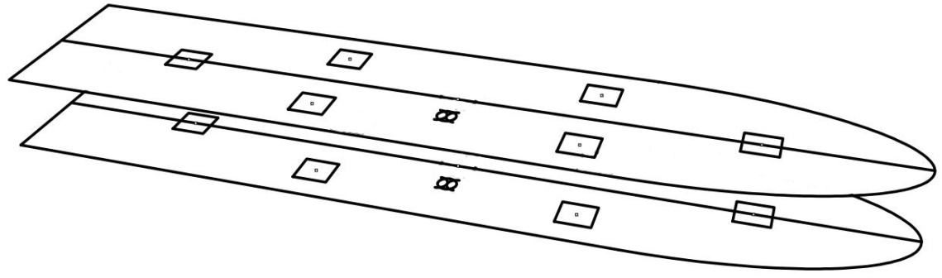
Overall Arrangement
Transmitter
Top Deck
Receiver
Bottom Deck

Slide 26
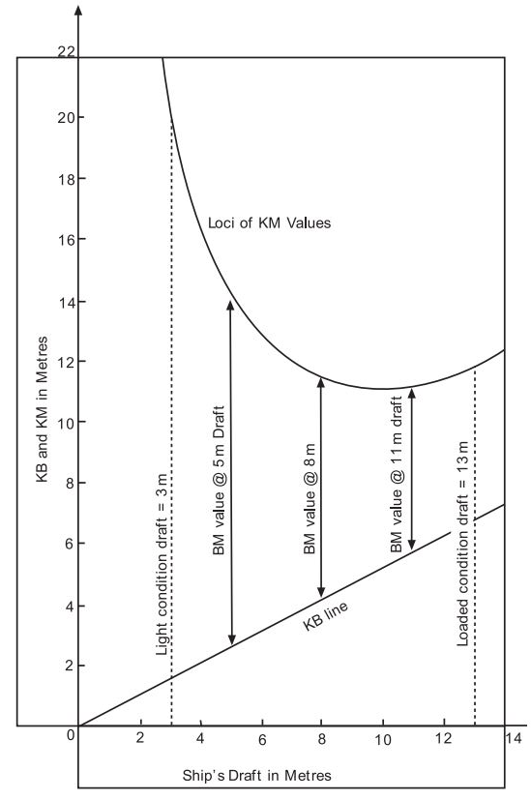
Metacnetric Diagram of a ship shaped vessel

Slide 27
Experimental Setup
Bluetooth
Transmitter
NodeA
Bluetooth
Transmitter
Microcontroller
Load Cell
Microcontroller
Load Cell
Receiver
Bluetooth
Microcontroller

Slide 28
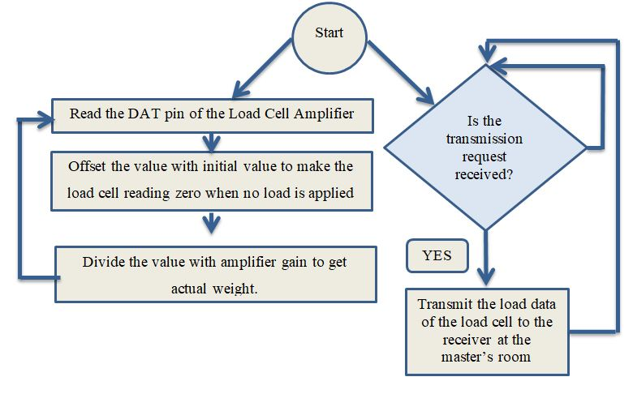
Transmitter Algorithm

Slide 29
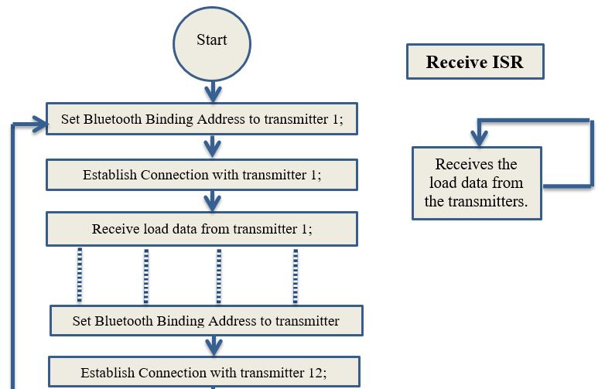
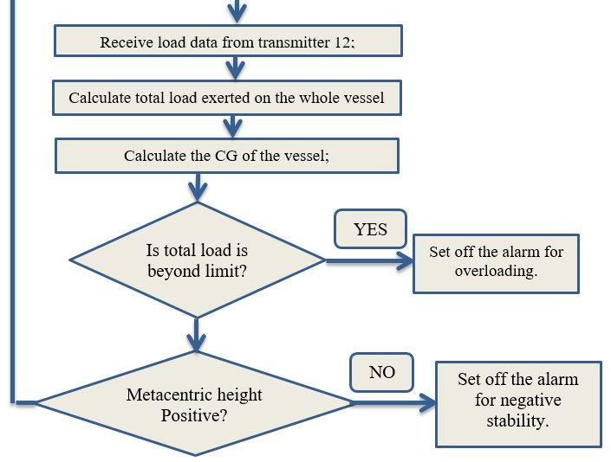
Receiver Algorithm

Slide 30
Results And Findings
Assumptions
Permissible Total Load: 5 kg
Z-coordinate of CG: 0 Meter (For Lightweight Vessel)
Z-coordinate of Metacenter: 3 Meter
Z-coordinate of NodeA: 4 Meter
Z-coordinate of NodeB: -1 Meter

Slide 31
Results And Findings
Load on NodeA | Load on NodeB | Total Load | CG | Remarks
3 kg | 3 kg | 6 kg | 1.5 meter | Overload and positive stability. Some load should be removed
1 kg | 3 kg | 4 kg | 0.25 | Safe loading and positive stability
0.5 kg | 4 kg | 4.5 kg | -0.4444 | Safe loading and positive stability
3 kg | 1 kg | 4 kg | 2.75 | Safe loading and approaching Neutral Stability. Should shift the load lower from NodeA or remove load.
4 kg | 0.6 kg | 4.6 kg | 3.347 m | Safe loading but negative stability. Should shift the load from NodeA or remove the load.

Slide 32
Challenges
The Metacenter is considered to be fixed for this project. But in reality metacenter shifts with the draft.
Load measurement is considered to be accumulated at a central point at the deck. But load is generally distributed over the deck.
In this project Bluetooth is used for the wireless network. But Bluetooth has some issues with range and connectivity. Bluetooth generally works good in open air and within short distance.

Slide 33
Future Work
Special care should be taken to ensure the structural integrity of the vessel.
Metacenter should be readily updated after consulting the design graph and draft.
At least more than 5 load cells should be mounted for a single deck.
Life size model to assess its effectiveness and viability.
For larger vessel Wi-Fi/GSM network may be considered.

Slide 34
THANK YOU

